Slide 1
Nicotine’s Effect in Oxidative Stress of Cells
Diploma Thesis
Laspas Panagiotis
Supervisor : L. Alexopoulos, Associate Professor, NTUA

Slide 2
Presentation contents
INTRODUCTION TO THE PROBLEM
STATE OF THE ART
METHODOLOGY
RESULTS
CONCLUSIONS

Slide 3
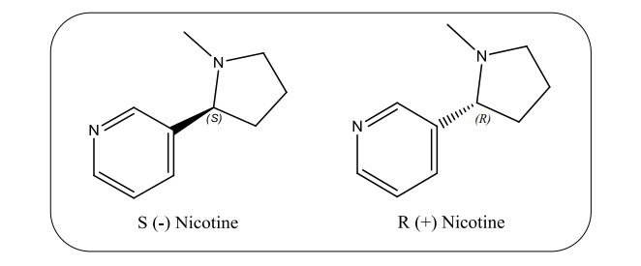
What is nicotine?
1) INTRODUCTION TO THE PROBLEM
comes from the plant Nicotiana tabacum,
one of the most potent alkaloids found in significant amounts in tobacco leaves, is also present in lower levels in potatoes, tomatoes and eggplants (below 10 μg/kg) .
Chemically : a tertiary amine, is composed of pyridine and pyrrolidine rings. It exists as two enantiomers in tobacco, levorotary (S) enantiomer and dextro (R), with S being predominant (>99%).1 (Figure 1.1).
Figure 1.1: Enantiomers of nicotine.

Slide 4
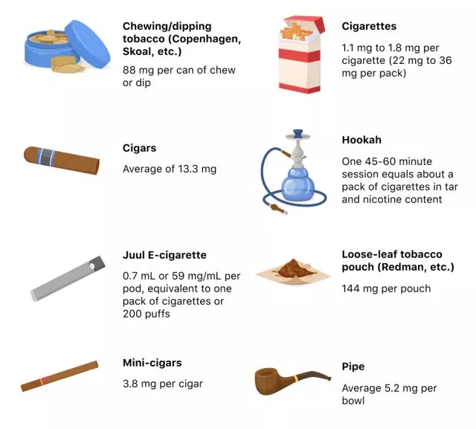
Nicotine content in the most desired tobacco products
Figure 1.2 : Mainly sources of Nicotine

Slide 5


Smoking in Numbers
At least 1,1 billion people in 2019
1 Death per 0,8 to 1,1 million cigarettes
People with stress and other psychiatric diagnosis have higher smoking prevalence
Figure 1.3 : Death rate from smoking on 2019
Figure 1.4 : European consumption in 2019

Slide 6
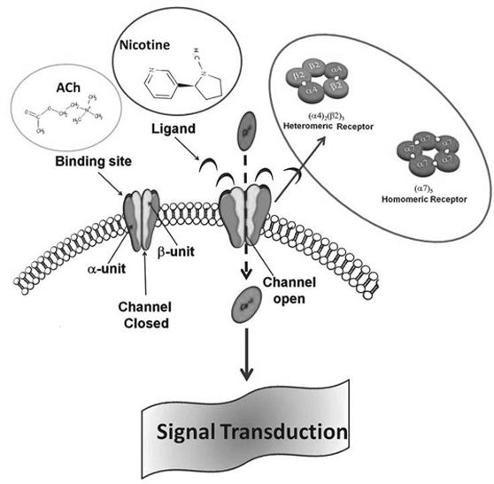
NICOTINE’S “happiness”… just biochemistry
  The nicotine from tobacco smoke is rapidly absorbed into the small airways and alveoli of the lungs, and then immediately enters and circulates in the blood.
  The large surface area of the alveoli and the small airways in the lungs, along with the lung fluid (pH 7.4), facilitate rapid absorption of high amounts of nicotine by the membranes.
  Nicotine, after entering pulmonary circulation, rapidly enters the brain and then stereo-selectively binds to the nicotinic cholinergic receptors (nAChRs).
  Stimulation of these receptors releases various neurotransmitters, including dopamine
Figure 1.5 : Nicotine’s “Happiness” Mechanism

Slide 7
According to reports Nicotine has benefits…
2) STATE OF THE ART
  Some papers have shown its protective role in patients with brain disorders such as Parkinson’s, Alzheimer’s, and schizophrenia.
  Some reports demonstrated that the transdermal administration of nicotine resulted in improvements in attention and information processing by Down’s syndrome patients, when compared to healthy controls.
  Researchers have also found that the chronic administration of nicotine might be beneficial to patients with dementia, where it acts as a cognitive enhancer.
  These beneficial effects of nicotine might be due to its antioxidant mechanism that is primarily related to the presence of free iron

Slide 8
…AND OF COURSE DRAWBACKS
Unlikely most people think, nicotine is not associated to cancer. Other ingredients in tobacco products are carcinogenic and harmful. Nicotine’s primary side effect is addiction.
Although nicotine has its own potential side effects.
Smoke is a complex mixture of more than 4700 chemical compounds including free radicals and oxidants.
Toxicity exhibited by cigarette smoke may be due to combined action of these compounds inducing many cellular processes mediated through reactive oxygen species (ROS). Major player probably nicotine as it is present in tobacco, in higher concentrations.
The compounds that induce intracellular oxidative stress recognized as the important agents involved in the damage of biological molecules.

Slide 9
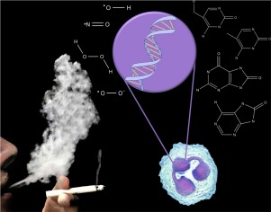

Reactive Oxygen Species
Reactive oxygen species are highly reactive, oxygen containing molecules that are the result of an incomplete reduction of molecular oxygen in the cell
ROS that are free radicals include the superoxide ($O_{2}^{•−}$), hydroxyl (HO•), peroxyl ( ${RO}_{2}^{•−}$), hydroperoxyl (${HO}_{2}^{•}$), and alkoxyl radicals (RO• )
ROS that are not free radicals include hydrogen peroxide (H₂O₂), the hydroxide ion (OH–) and organic peroxides (ROOH)
In general, harmful effects of reactive oxygen species on the cell are most often:
  damage of DNA or RNA
  oxidations of polyunsaturated fatty acids in lipids
  oxidations of amino acids in proteins
  oxidative deactivation of specific enzymes by oxidation of co-factors
Figure 2.1 : ROS Mechanisms

Slide 10

Aim of this study
The primary aim of this study is to determine the role of nicotine in oxidative stress, particularly in the lung cells, where nicotine initially enters and circulates throughout the body.
Compare nicotine’s role in oxidative stress with an other heavily oxidative substance ($H_{2}O_{2}$ )

Slide 11
3) METHODOLOGY
Materials
Cell Line : NCI-H292 4th passage
Chemical Ingredients for the Cultures
  Solution 90% v/v FBS , 10% v/v DMSO
  RPMI (10 % v/v FBS, NEA, L- glutamine, Anti-biotics)
  Trypsin
Specific devices used for the cell cultures and the measurements
  Pipettes
  Bauer Device
  Various Scan Device
  Centrifuge Device
  Cell culture plates
  etc.

Slide 12

CELL THAWING AND PROCESSING
Cells were maintained in liquid nitrogen
Stirring in ${37}^{o}C$ liquid (duration ≈ 2 min)
Placement in 75-type flask
Every 5-7 days new cell passaging (no more space in the flask and need for more cells)
Repeating the same processes until the cells become passage 15
After passages 10 and 15 some cells placed in specific plates so they can be processed
Although there are two different experiments (because there are two different oxidative substances) the cells used in both of them were the same

Slide 13
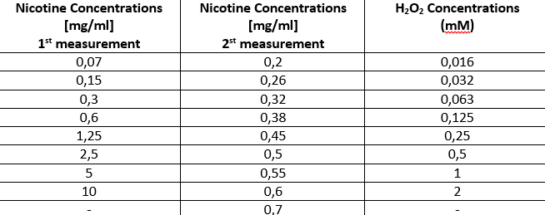


CELL’S PROCESS
Each plate has 96 wells (8 rows x12 columns) and in each well there are placed 15.000 cells and 100 μl nutrient material.
Nicotine and $H_{2}O_{2}$ are subjected to successive dilutions.
Every different concentration in pipetted in a well
incubations of various time intervals were carried out
Figure 3.1 : Nicotine’s and $H_{2}O_{2}$’s concentrations
Figure 3.2 : Incubation Periods

Slide 14
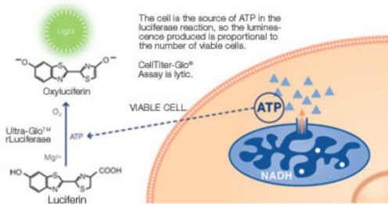
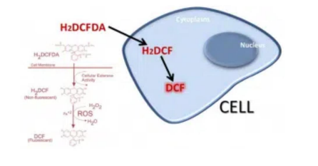

ATP AND ROS MEASUREMENTS
ATP and ROS are two different indicators
ATP shows cell’s viability (through the CellTiter-Glo® Luminescent Cell Viability Assay method).
ROS shows how many cells are in oxidative stress, which is almost the opposite of the ATP’s viability.
For every different concentration of nicotine and $H_{2}O_{2}$ there is a different measurement of ATP and ROS.
The difference is being shown in the diagrams bellow.
Figure 3.3 : ATP measurement’s method
Figure 3.4 : ROS measurement’s method

Slide 15
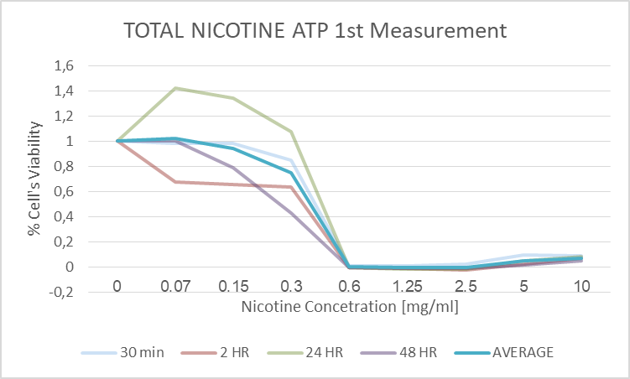
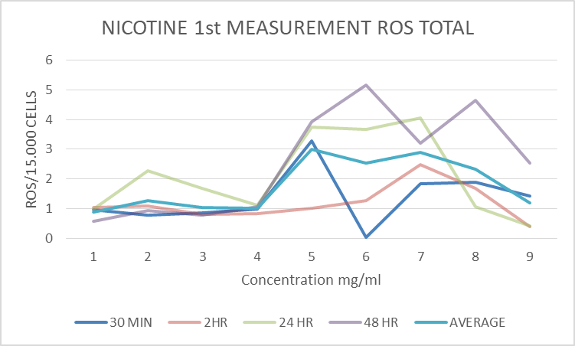
4) RESULTS
NICOTINE’S RESULTS
1st MEASUREMENT
  There were conducted two different measurements in order to compare the results. The first one was on a larger scale of dilutions while the second one was more limited.
  When ATP is approximately 1, cell’s viability is maximum and nicotine’s concentration is almost 0.
  When ROS is approximately 1, cells are in high oxidative stress and nicotine’s concentration is high.
Figure 4.1 : Nicotine’s 1st measurement ATP
Figure 4.2 : Nicotine’s 1st measurement ROS

Slide 16
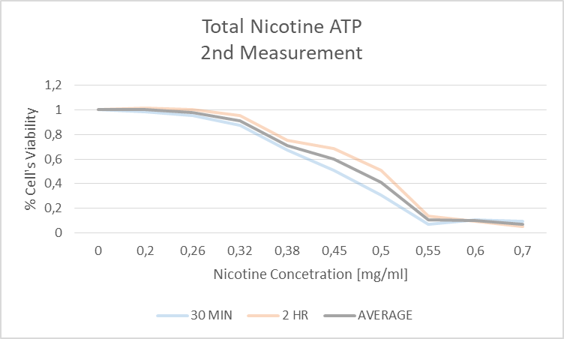
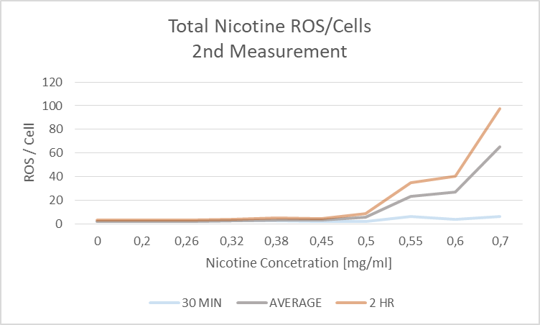
NICOTINE’S RESULTS
2st MEASUREMENT
2nd measurement is from 0 mg/ml to 0.7 mg/ml because on bigger concentrations the results are stable
Figure 4.3 : Total ATP Nicotine 2nd measurement
Figure 4.4 : Total Nicotine ROS 2nd measurement

Slide 17
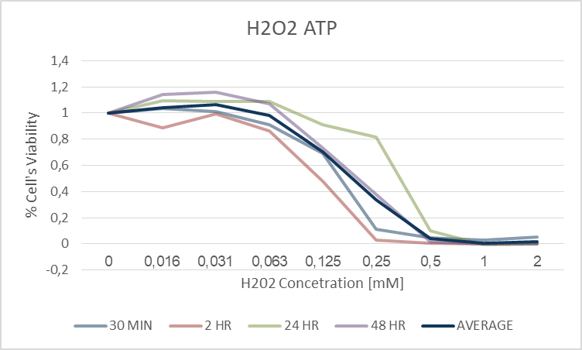
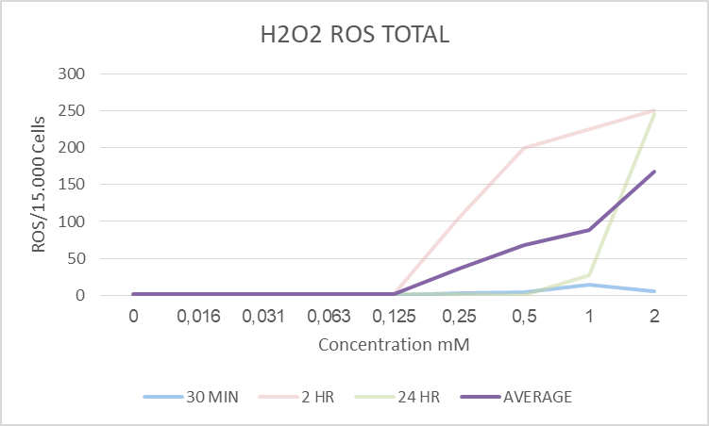



$H_{2}O_{2}$’S RESULTS (ONLY 1 MEASUREMENT)
Figure 4.5 : $H_{2}0_{2}$ Total ATP
Figure 4.6 : $H_{2}0_{2}$ Total ROS

Slide 18

5) CONCLUSIONS
Nicotine in high concentrations indeed is toxic fir the cells (above 0.2 mg/ml !)
Although in lower concentrations it doesn’t affect them
In comparison with $H_{2}O_{2}$ much weaker oxidative substance (1M = 126mg/ml 25 times faster stress!)
Although nicotine is harmful to the cells in high concentrations, it is still a highly addictive substance at any concentration.
In tobacco products nicotine is at least 1mg, except Juul E-cigarettes

Slide 19
SPAECIAL THANKS TO :
L. Alexopoulos, Associate Professor, NTUA and supervisor of this project
E. Kanellis, diploma student, NTUA
The other members of the Biolab

Slide 20
Questions, Comments, Observations
THE END
THANK YOU FOR YOUR ATTENTION!

