Slide 1


Container Storage Interface (CSI) Volume Plugin
for Multi-Terabyte, Unified Filesystem Hierarchies
over Local Storage Kubernetes Clusters
Georgios Thomadakis <gthomadakis@protonmail.com>
Undergraduate student, ECE NTUA
Diploma thesis - March 2024

Slide 2
Overview
Kubernetes context
Storage landscape
Enter Union CSI
Background
Implementation
Evaluation
Conclusion

Slide 3

Kubernetes
Container Orchestrator
node1
node2
node3
Worker Nodes
Node
Node
Node
Kubelet
Kubelet
Kubelet
app 2
app 1
app 1
app 3

Slide 4

The Operator Pattern
apiVersion: v1
kind: Pod
metadata:
name: mypod
...
spec:
...
apiVersion: v1
kind: Pod
metadata:
name: mypod
...
spec:
...
status:
...
Kubernetes objects
Cluster resources
desired
actual
Service
PV
watch
Controller
update
Pod
mypod
write
User
update
watch
CRD

Slide 5
A (dynamic) storage story in Kubernetes
Control
Plane
apiVersion: v1
kind: Pod
metadata:
name: mypod
spec:
containers:
- name: nginx
image: nginx:stable-alpine
volumeMounts:
- name: vol
mountPath: /data
volumes:
- name: vol
persistentVolumeClaim:
claimName: myclaim
apiVersion: v1
kind: PersistentVolumeClaim
metadata:
name: myclaim
spec:
storageClassName: myclass
accessModes:
- ReadWriteOnce
resources:
requests:
storage: 5Gi
Controller Manager
Scheduler
write
apply
API Server
etcd
User
Storage driver
Local storage
Remote access
apiVersion: storage.k8s.io/v1
kind: StorageClass
metadata:
name: myclass
provisioner: awesome.storage
parameters:
type: very-fast
fsType: ext4
volumeBindingMode: Immediate
reclaimPolicy: Delete
node1
Node
Kubelet
SC
myclass
Awesome Storage
create
provision
attach
Pod
mypod
PVC
myclaim
PV
pv-name
Volume
bound

Slide 6
Overview
Kubernetes context
Storage landscape
Enter Union CSI
Background
Implementation
Evaluation
Conclusion

Slide 7
The problem
apiVersion: v1
kind: PersistentVolumeClaim
metadata:
name: pvc2
spec:
storageClassName: myclass
accessModes:
- ReadWriteOnce
resources:
requests:
storage: 400Gi
3 x 256 GiB
=
768 total GiB
available in the cluster
!
PVC
pvc2
Awesome Storage
create
568
User
consider
X
X
X
node1
node2
node3
Node
Node
Node
apiVersion: v1
kind: PersistentVolumeClaim
metadata:
name: pvc1
spec:
storageClassName: myclass
accessModes:
- ReadWriteOnce
resources:
requests:
storage: 200Gi
Kubelet
Kubelet
Kubelet
PVC
pvc1
Pod
pod1
NVMe
256 GiB
NVMe
256 GiB
NVMe
256 GiB
local storage

Slide 8







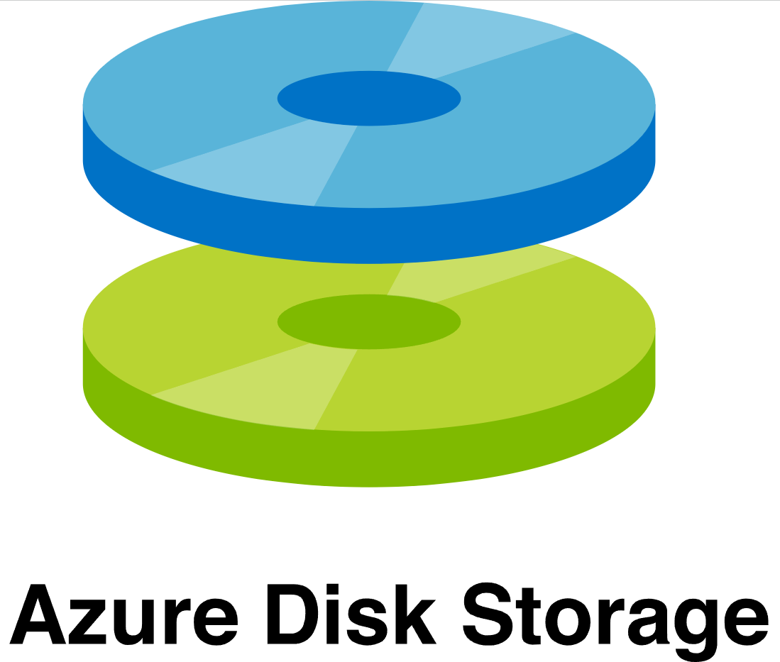
Existing solutions
iSCSI
NFS
Storage pooling
Fast
Replicated
Distributed
NVMe
Software-defined storage
Remote storage
FUSE
Simple
Local storage
Bloated
LVM
Highly
available
Linux kernel
Snapshots
DRBD
Scalable
Slow(er)
Flexible

Slide 9
Overview
Kubernetes context
Storage landscape
Enter Union CSI
Background
Implementation
Evaluation
Conclusion

Slide 10
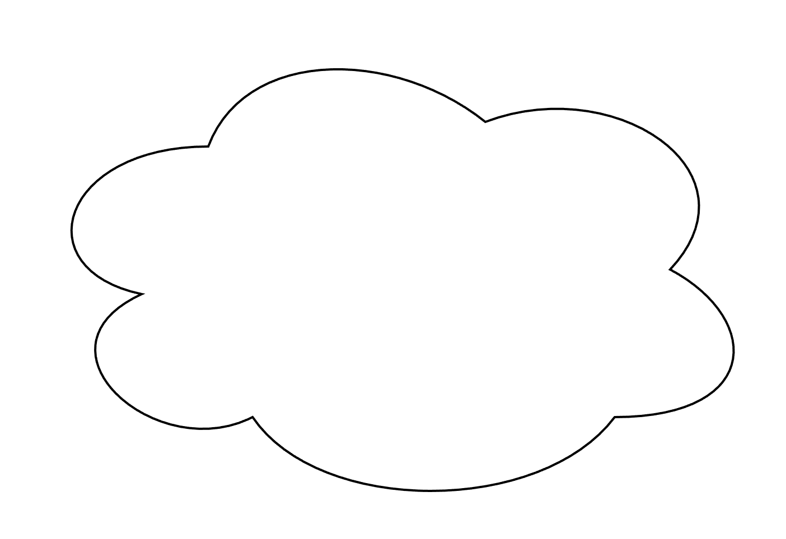

Union CSI
PVC
Union CSI
User
600 GiB
3 x 200 GiB
PVC
PVC
PVC
Awesome Storage
node1
node2
node3
Node
Node
Node
256 GiB
256 GiB
256 GiB
v1
v2
v3
200 GiB
200 GiB
200 GiB
v3
600 GiB
v2
v1

Slide 11
Overview
Kubernetes context
Storage landscape
Enter Union CSI
Background
Implementation
Evaluation
Conclusion

Slide 12








CSI (Container Storage Interface)
Container Orchestrator Systems
UNIX socket
CO
RPC
CSI driver
Storage
backend
...
gRPC client
gRPC server
Kubernetes
Mesos
Docker Swarm
Cloud Foundry
Features
Support block and mount volumes
Create/delete volumes
Attach/detach volumes
Mount/unmount volumes
Snapshot volumes
Expand volumes
...
Amazon EBS
Azure Disk
GCP PD
Ceph
Storage Systems

Slide 13
CSI - Architecture
CSI Driver
3 sets of RPCs
Node service
Controller service
Identity service
3 modes of operation
Node Plugin
Controller Plugin
both (unified Plugin)
Controller Plugin
Node Plugin
Controller service
CreateVolume
DeleteVolume
ControllerPublishVolume
ControllerUnpublishVolume
ValidateVolumeCapabilities
ListVolumes
GetCapacity
ControllerGetCapabilities
CreateSnapshot
DeleteSnapshot
ListSnapshots
ControllerExpandVolume
ControllerGetVolume
Node service
NodeStageVolume
NodeUnstageVolume
NodePublishVolume
NodeUnpublishVolume
NodeGetVolumeStats
NodeExpandVolume
NodeGetCapabilities
NodeGetInfo
Identity service
GetPluginInfo
GetPluginCapabilities
Probe

Slide 14
CSI - Main Remote Procedure Calls (RPCs)
Controller service
CreateVolume / DeleteVolume
ControllerPublishVolume / ControllerUnpublishVolume: attach/detach (e.g. EBS)
Node service
NodePublishVolume / NodeUnpublishVolume: mount/unmount (e.g. mount(2)/umount(2) on Linux)

Slide 15

Kubernetes & CSI
watch
watch
Node
Node
Kubelet
Kubelet
Pod
Pod
gRPC
CSI Provisioner
CSI
Attacher
...
Node Driver Registrar
gRPC
gRPC
Controller Plugin
Node Plugin
Sidecar container provided by Kubernetes Storage SIG
Storage
backend
Master container provided by third-party storage vendor

Slide 16
Kubernetes & CSI - Node Plugin registration
update
apiVersion: v1
kind: Node
metadata:
name: node1
labels:
region: r1
zone: z2
...
...
spec:
...
status:
...
node1
owner
reference
node1
CSINode
Node
Kubelet
create/update
GetPluginInfo
NodeGetInfo
apiVersion: storage.k8s.io/v1
kind: CSINode
metadata:
name: node1
...
spec:
drivers:
- name: csi-plugin.org
nodeID: nodeA
topologyKeys:
- region
- zone
...
...
GetPluginInfo
/var/lib/kubelet/plugins_registry
/csi-plugin.org-reg.sock
/var/lib/kubelet/plugins
/csi-plugin.org/csi.sock
hostPath
/var/lib/kubelet
Pod
GetPluginInfoResponse:
name: csi-plugin.org
vendor_version: v0.1.0
Node Driver Registrar
Node Plugin
NodeGetInfoResponse:
node_id: nodeA
accessible_topology:
segments:
region: r1
zone: z2

Slide 17
Kubernetes & CSI - Creating volumes
apiVersion: v1
kind: PersistentVolume
metadata:
annotations:
pv.kubernetes.io/provisioned-by: csi-plugin.org
name: pvc-cc883c26-e1d1-41ce-bd98-10f2c21d5819
...
spec:
...
storageClassName: class-example
claimRef:
apiVersion: v1
kind: PersistentVolumeClaim
name: pvc-example
namespace: default
resourceVersion: "213485"
uid: cc883c26-e1d1-41ce-bd98-10f2c21d5819
csi:
driver: csi-plugin.org
volumeHandle: selectedVolumeID
...
apiVersion: v1
kind: PersistentVolume
metadata:
annotations:
pv.kubernetes.io/provisioned-by: csi-plugin.org
name: pvc-cc883c26-e1d1-41ce-bd98-10f2c21d5819
...
spec:
...
storageClassName: class-example
claimRef:
apiVersion: v1
kind: PersistentVolumeClaim
name: pvc-example
namespace: default
resourceVersion: "213485"
uid: cc883c26-e1d1-41ce-bd98-10f2c21d5819
csi:
driver: csi-plugin.org
volumeHandle: selectedVolumeID
...
status:
phase: Bound
...
PersistentVolume controller
(Controller Manager)
apiVersion: v1
kind: PersistentVolumeClaim
metadata:
name: pvc-example
spec:
storageClassName: class-example
...
apiVersion: v1
kind: PersistentVolumeClaim
metadata:
annotations:
volume.kubernetes.io/storage-provisioner: csi-plugin.org
name: pvc-example
uid: cc883c26-e1d1-41ce-bd98-10f2c21d5819
...
spec:
storageClassName: class-example
...
status:
phase: Pending
...
apiVersion: v1
kind: PersistentVolumeClaim
metadata:
annotations:
pv.kubernetes.io/bind-completed: "yes"
pv.kubernetes.io/bound-by-controller: "yes"
volume.kubernetes.io/storage-provisioner: csi-plugin.org
name: pvc-example
uid: cc883c26-e1d1-41ce-bd98-10f2c21d5819
...
spec:
storageClassName: class-example
volumeName: pvc-cc883c26-e1d1-41ce-bd98-10f2c21d5819
...
status:
phase: Bound
...
watch & update
PVC
PV
bound
watch
create
Pod
CSI Provisioner
CreateVolumeRequest:
name: pvc-cc883c26-e1d1-41ce-bd98-10f2c21d5819
...
apiVersion: storage.k8s.io/v1
kind: StorageClass
metadata:
name: class-example
provisioner: csi-plugin.org
volumeBindingMode: Immediate
...
CreateVolume
SC
Controller Plugin
provision
Volume
CreateVolumeResponse:
volume:
volume_id: selectedVolumeID
...

Slide 18
Kubernetes & CSI - Attaching & mounting volumes
apiVersion: v1
kind: Pod
metadata:
...
spec:
...
nodeName: node1
volumes:
- name: vol
persistentVolumeClaim:
claimName: pvc-example
status:
phase: Running
...
apiVersion: v1
kind: Pod
metadata:
...
spec:
...
nodeName: node1
volumes:
- name: vol
persistentVolumeClaim:
claimName: pvc-example
status:
phase: Pending
...
AttachDetach controller
(Controller Manager)
node1
apiVersion: storage.k8s.io/v1
kind: VolumeAttachment
metadata:
...
spec:
attacher: csi-plugin.org
nodeName: node1
source:
persistentVolumeName: pvc-cc883c26-e1d1-41ce-bd98-10f2c21d5819
CSINode
apiVersion: storage.k8s.io/v1
kind: VolumeAttachment
metadata:
...
spec:
attacher: csi-plugin.org
nodeName: node1
source:
persistentVolumeName: pvc-cc883c26-e1d1-41ce-bd98-10f2c21d5819
status:
attached: false
apiVersion: storage.k8s.io/v1
kind: VolumeAttachment
metadata:
...
spec:
attacher: csi-plugin.org
nodeName: node1
source:
persistentVolumeName: pvc-cc883c26-e1d1-41ce-bd98-10f2c21d5819
status:
attached: true
create & watch
watch
owner
reference
VA
node1
Node
watch
watch & update
mount &
run
Kubelet
/var/lib/kubelet/...
Pod
Pod
update
CSI
Attacher
Node
Publish
Volume
ControllerPublishVolumeRequest:
volume_id: selectedVolumeID
node_id: nodeA
...
Controller
Publish
Volume
format & mount
Pod
Controller Plugin
attach
Volume
Node Plugin
Node Driver Registrar
ControllerPublishVolumeResponse: {}

Slide 19
MergerFS
$ tree .
.
├── branch
│ ├── dir1
│ │ └── file1
│ └── dir2
│ │ └── file3
│ └── file5
├── otherbranch
│ ├── dir1
│ │ └── file2
│ └── dir3
│ └── file4
└── mntpt
$ mergerfs branch:otherbranch mntpt
$ tree mntpt
mntpt
├── dir1
│ ├── file1
│ └── file2
├── dir2
│ └── file3
└── dir3
│ └── file4
└── file5
$ mount | grep mergerfs
/dev/sda on /home/user/mergerfs-test/branch type ext4 ...
/dev/sdb on /home/user/mergerfs-test/otherbranch type xfs ...
branch:otherbranch on /home/user/mergerfs-test/mntpt type fuse.mergerfs ...
MergerFS daemon
Application
libc
libfuse
libc
Userspace
Kernelspace
VFS
FUSE
Ext4
XFS
...
/dev/sda
/dev/sdb

Slide 20
Overview
Kubernetes context
Storage landscape
Enter Union CSI
Background
Implementation
Evaluation
Conclusion

Slide 21
Union CSI
PVC
Union CSI
1. split
3. collect on node1
5. merge
upper
User
600 GiB
lower
3 x 200 GiB
PVC
PVC
PVC
!
PVC
Awesome Storage
create v1 on node1
2. create v2 on node2
create v3 on node3
4. attach v2 & v3 on node1
User
600 GiB
node1
node2
node3
Node
Node
Node
Union CSI volume
=
MergerFS mount
v3
v2
v1
v3
v2
v1
v2
v3
MergerFS
256 GiB
256 GiB
256 GiB
Linux kernel
Linux kernel
Linux kernel
TCP/IP

Slide 22
Union CSI - StorageClass
apiVersion: v1
kind: PersistentVolumeClaim
metadata:
name: myclaim
spec:
accessModes:
- ReadWriteOnce
resources:
requests:
storage: 400Gi
storageClassName: union
apiVersion: storage.k8s.io/v1
kind: StorageClass
metadata:
name: myclass
provisioner: awesome.storage
parameters:
type: very-fast
fsType: ext4
volumeBindingMode: Immediate
reclaimPolicy: Delete
apiVersion: storage.k8s.io/v1
kind: StorageClass
metadata:
name: union
provisioner: csi.union.io
parameters:
lowerStorageClassName: myclass
volumeBindingMode: Immediate
reclaimPolicy: Delete
PVC
myclaim
SC
union
SC
myclass
User
Union CSI
Awesome Storage
upper
lower

Slide 23
Union CSI - The VolumeSplit custom resource
apiVersion: union.io/v1alpha1
kind: VolumeSplit
metadata:
name: split-123
namespace: union
spec:
capacity: 150Gi
replicas: 3
template:
spec:
accessModes:
- ReadWriteOnce
resources:
requests:
storage: 50Gi
storageClassName: standard
apiVersion: v1
kind: PersistentVolumeClaim
metadata:
generateName: split-123-
namespace: union
ownerReferences:
- apiVersion: union.io/v1alpha1
blockOwnerDeletion: true
controller: true
kind: VolumeSplit
name: mysplit
uid: 9a5443c8-ab27...
spec:
accessModes:
- ReadWriteOnce
resources:
requests:
storage: 50Gi
storageClassName: standard
Volume
Split
custom resource
owner
reference
PVC
PVC
PVC
Union CSI needs:
Single source of truth
Storing & retrieving data
Sets of PVCs

Slide 24
Union CSI - Creating volumes
CreateVolumeRequest:
name: pvc-4c8ccf55...
capacity_range:
required_bytes: 429496729600
volume_capabilities:
- access_type:
mount: {}
access_mode:
mode: 1
parameters:
lowerStorageClassName: myclass
union
apiVersion: union.io/v1alpha1
kind: VolumeSplit
metadata:
name: split-pvc-4c8ccf55...
namespace: union
...
spec:
capacity: 400Gi
replicas: 2
template:
spec:
accessModes:
- ReadWriteOnce
resources:
requests:
storage: 200Gi
storageClassName: myclass
apiVersion: union.io/v1alpha1
kind: VolumeSplit
metadata:
name: split-pvc-4c8ccf55...
namespace: union
...
spec:
capacity: 400Gi
replicas: 2
template:
spec:
accessModes:
- ReadWriteOnce
resources:
requests:
storage: 200Gi
storageClassName: myclass
status:
conditions:
- lastTransitionTime: "2024-01-18T20:09:36Z"
message: Replica "split-pvc-4c8ccf55..." was created successfully
reason: NewReplicaCreated
status: "True"
type: Progressing
...
apiVersion: union.io/v1alpha1
kind: VolumeSplit
metadata:
name: split-pvc-4c8ccf55...
namespace: union
...
spec:
capacity: 400Gi
replicas: 2
template:
spec:
accessModes:
- ReadWriteOnce
resources:
requests:
storage: 200Gi
storageClassName: myclass
status:
conditions:
- lastTransitionTime: "2024-01-18T20:10:16Z"
message: VolumeSplit has all its replicas bound
reason: AllBound
status: "True"
type: Ready
...
Pod
create & wait for Ready condition
Volume
Split
Union CSI Controller Plugin
watch &
update
Pod
PVC
PVC
create
VolumeSplit controller
CreateVolumeResponse:
volume:
volume_id: pvc-4c8ccf55...
SC
myclass
PV
PV
node1
node2
Awesome Storage
Node
Node
provision volumes
NVMe
256GiB
NVMe
256GiB

Slide 25
Union CSI - The Attach-Pod
apiVersion: v1
kind: Pod
metadata:
name: pod-split-123
namespace: union
spec:
nodeSelector:
kubernetes.io/hostname: node1
containers:
- name: gogomergerfs
image: docker.io/on2e/gogomergerfs:dev-mergerfs2.37.1
command:
- /bin/sh
args:
- -c
- gogomergerfs mergerfs --branches=/volume/branches/\*
--target=/volume/merged --block
securityContext:
privileged: true
volumeMounts:
- mountPath: /volume/branches/branch0-split-123-b22xk
name: branch0
- mountPath: /volume/branches/branch1-split-123-h8rgj
name: branch1
- mountPath: /volume/branches/branch2-split-123-dha7t
name: branch2
- mountPath: /volume/merged
mountPropagation: Bidirectional
name: target
...
Volume
Split
custom resource
owner
reference
PVC
PVC
PVC
...
volumes:
- name: branch0
persistentVolumeClaim:
claimName: split-123-b22xk
- name: branch1
persistentVolumeClaim:
claimName: split-123-h8rgj
- name: branch2
persistentVolumeClaim:
claimName: split-123-dha7t
- hostPath:
path: /var/lib/union-csi/volumes/123/merged
type: DirectoryOrCreate
name: target
Pod
MergerFS
hostPath
MergerFS
mount

Slide 26
Union CSI - The Gogomergerfs program
MergerFS mount
/var/lib/union-csi/volumes/<volume-id>/merged
hostPath
gogomergerfs mergerfs --branches=/volume/branches/\* --target=/volume/merged
--block
bidirectional
Pod
Running
Gogomergerfs
container
mergerfs
/volume/branches/\* /volume/merged
/volume/merged/
mergerfs
/volume/branches/\*
/volume/merged
SIGINT, SIGTERM
block
/volume/branches/
Terminating
umount /volume/merged
lower
volumes
pvc
pvc
pvc

Slide 27
Union CSI - Attaching volumes
apiVersion: v1
kind: Pod
metadata:
name: pod-pvc-4c8ccf55...
namespace: union
...
spec:
nodeSelector:
kubernetes.io/hostname: node3
nodeName: node3
...
status:
phase: Pending
...
apiVersion: v1
kind: Pod
metadata:
name: pod-pvc-4c8ccf55...
namespace: union
...
spec:
nodeSelector:
kubernetes.io/hostname: node3
nodeName: node3
...
status:
phase: Running
...
create & wait for Running phase
ControllerPublishVolume
Request:
volume_id: pvc-4c8ccf55...
node_id: node3
volume_capability:
access_type:
mount: {}
access_mode:
mode: 1
volume_context:
...
union
Pod
get & list owned replicas
Volume
Split
Union CSI Controller Plugin
watch &
update
Pod
PVC
PVC
ControllerPublishVolume
Response: {}
VolumeSplit controller
node3
Node
/var/lib/union-csi/volumes
/pvc-4c8ccf55.../merged
Kubelet
SC
myclass
PV
PV
union
node1
node2
Pod
Pod
Pod
Awesome Storage
Node
Node
Union CSI Node Plugin
Consumer Pod
attach & mount volumes
NVMe
256GiB
NVMe
256GiB
NVMe
256 GiB
TCP/IP

Slide 28
Union CSI - Mounting volumes
node3
Node
Kubelet
/var/lib/union-csi
/var/lib/kubelet
hostPath
hostPath
volumes/pvc-4c8ccf55.../merged
mount
NodePublishVolumeRequest:
volume_id: pvc-4c8ccf55...
target_path: /var/lib/kubelet/pods/878a41c0-0266.../volumes/kubernetes.io~csi/pvc-4c8ccf55.../mount
volume_capability:
access_type:
mount: {}
access_mode:
mode: 1
...
pods/878a41c0-0266…
/volumes/kubernetes.io~csi/pvc-4c8ccf55.../mount
bind mount
union
Attach
Pod
Pod
Pod
Pod
Union CSI Node Plugin
Consumer Pod
NodePublishVolumeResponse: {}
pvc
pvc
NVMe
256 GiB

Slide 29
Overview
Kubernetes context
Storage landscape
Enter Union CSI
Background
Implementation
Evaluation
Conclusion

Slide 30


Evaluation
Environment
AKS Kubernetes cluster with 2 nodes
Each node (Standard_DS2_v2):
  2 vCPU cores
  7 GiB RAM
  128 GiB local SSD
Plugins & Test cases
Local Path Provisioner
  Local
Longhorn
  Longhorn
  Longhorn + iSCSI
Union CSI with 1. and 2.
  Union + Local
  Union + Longhorn
  Union + Longhorn + iSCSI
Local
Union + Local
Node
Node
IO Pod
IO Pod
Longhorn
Union + Longhorn
Node
Node
IO Pod
IO Pod
Longhorn + iSCSI
Union + Longhorn + iSCSI
Node
Node
Node
Node
IO Pod
IO Pod

Slide 31
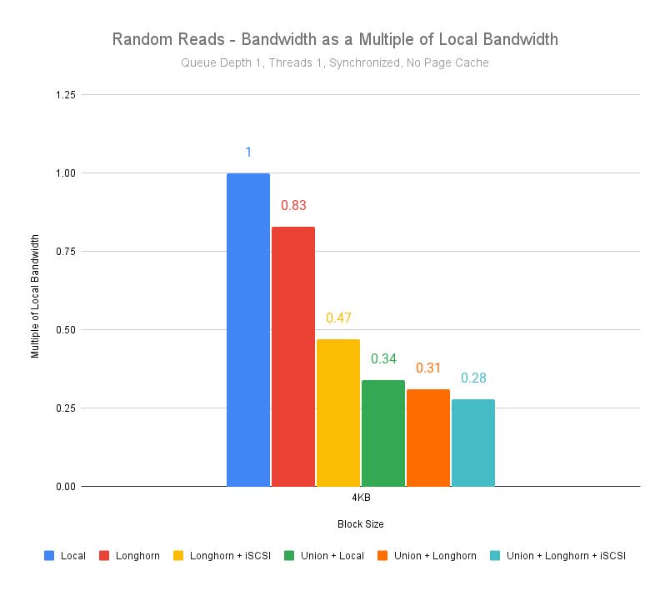
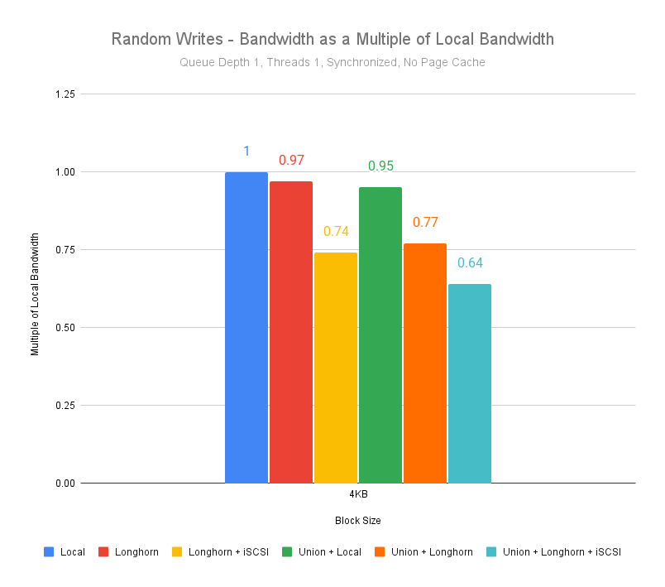
Evaluation – Results
-5%
-66%
-21%
-63%
-14%
-40%
It’s FUSE :( ...

Slide 32
Overview
Kubernetes context
Storage landscape
Enter Union CSI
Background
Implementation
Evaluation
Conclusion

Slide 33
Conclusion
Pros
Scalable
Add it with your favorite storage flavor
Simple
Cons
FUSE overhead
Limited # of lower plugins to use
Fixed splittings

Slide 34
Conclusion - Future work
What’s next?
Allow user to configure and update # of capacity splits (e.g. ConfigMap)
Understand and test thoroughly MergerFS
  Goal stretch: Explore a kernelspace implementation
Make composition generic (e.g., cached storage pools, bcachefs)
Publish our work as OSS

Slide 35
Thank you!
Questions?

